Slide 1
Choropleth Map & classification methods
2020.02.25
Dr. Sharon Hsiao

Slide 2
Statistics
Data type: Discrete vs Continuous
# of vs range of
Points vs area
Data level: Nominal, Ordinal, Interval, Ratio
Nominal: Has name or class only
Ordinal: Has rank only
Interval: Has value on arbitrary scale
Ratio: Has value on scale with absolute zero value
Notes:
Data type depends on how we treat the data.
Different levels consist of different information layers.
In DV this diff levels it means we have to implement different techniques into it.

Slide 3
Normalization: Transforms measures of magnitude (counts or weights) into measures of intensity
Factoring out the size of the domain when you wish to compare counts collected over unequal areas or populations.
Notes:
Hoping that we can convert the potential points of data as measures of intensity.
IT depends on how we ask the questions,

Slide 4
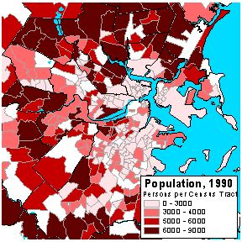
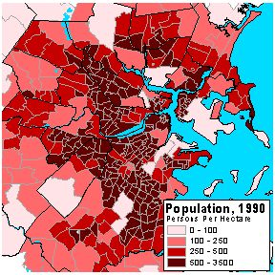
Population Density = Count of Population / Land Area (left)
Percent Unemployed = Count of Unemployed / Number in Workforce (right)
Notes:
How to make comparisons fair? By Normalization. Because different state’s sizes are different.

Slide 5
The choice of the denominator depends on the question being investigated.
i.e. to investigate the impact of automobiles on the environment, appropriate normalized statistic might be Autos-Per-Hectare; to investigate a question of commuting behavior, Autos-Per-Household could be more appropriate.
Note: there are several types of statistics that are not appropriate for normalization. Summary statistics, such as averages, medians, or percentages are already measures of intensity and should not be normalized.
Notes:
To make sure we get correct visual and correct distribution.
Compound statistics should not be normalized. They are using intensity already.

Slide 6



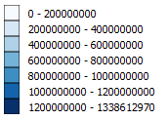
Deciding Classification for Choropleth Maps
EQUAL INTERVAL //use when data is evenly distributed
Avoid equal interval if your data are skewed to one end or if you have one or two really large outlier values. //avoid particular skewed data.
QUANTILES: //stretched out distribution, every beam carries same amount.
Drawback: you can end up with classes that have very different numerical ranges (e.g., 1-4, 4-9, 9-250…the last class is huge)
NATURAL BREAKS (JENKS)
Drawback: each dataset generates a unique classification solution, not suitable for comparing across series. //not generalizable. Take into account the standard deviation and stuff. Harder to compare across a series. Try to optimiza potential skewed distributions and potential large classes.
PRETTY BREAKS. //compound technique of natural breaks. The difference here is that they usually round up the divisions. Allows us to do each class comparison.
Notes:
Cf: https://gisgeography.com/choropleth-maps-data-classification/
How many divisions/beams we need per group?
Maps collide in so many ways. If classifications are decided by different intervals , every class will result in a different interpretation. The units may tell a totally different story.

Slide 7
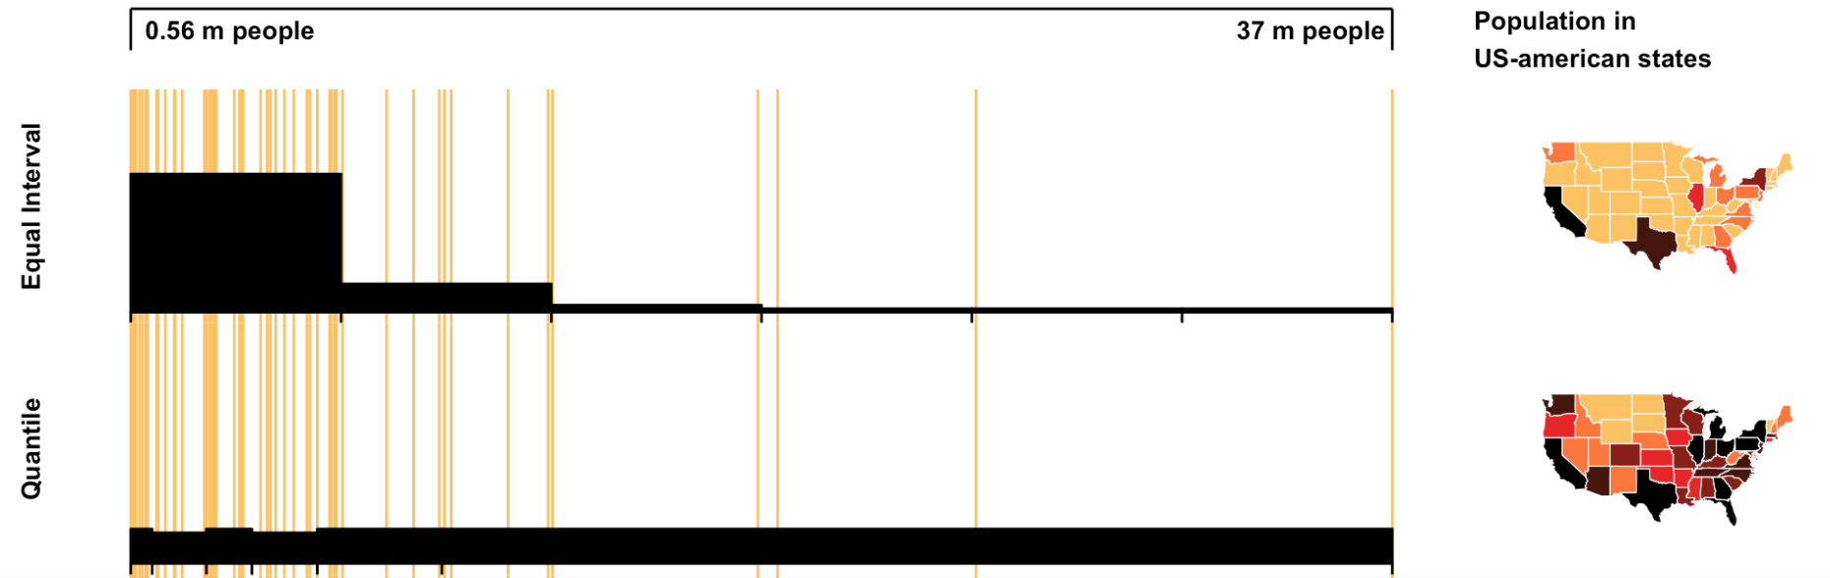

Slide 8
Choropleth map
Collect data at points, count points in polygon, normalize by area, then classify for choropleth map.
// it can be a ratio. The normalization is determined by denominator. Then the classification type is decided for each map.

Slide 9
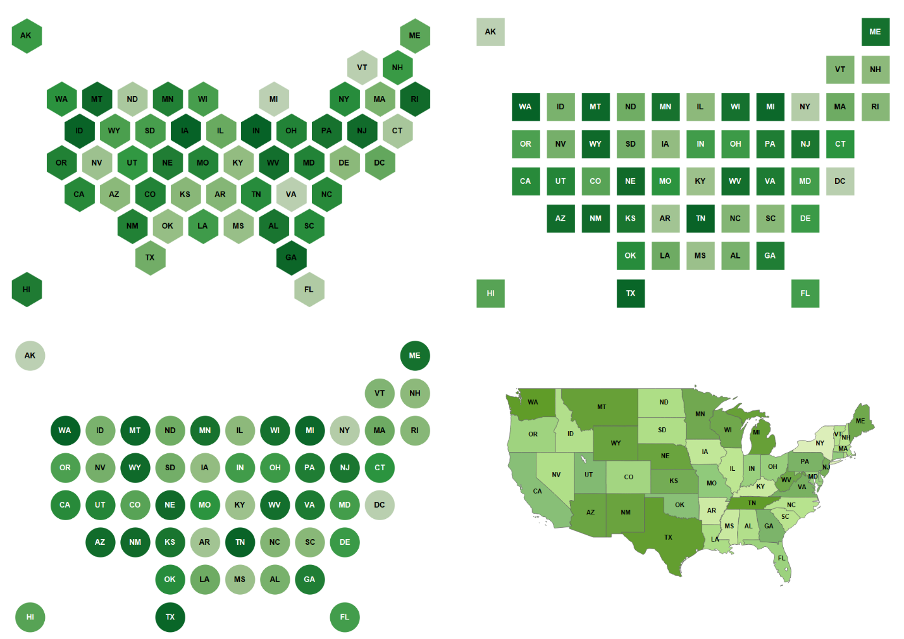
Hex Tile maps in Tableau
http://blog.apps.npr.org/2015/05/11/hex-tile-maps.html
Interactive vis + small multiples
https://projects.fivethirtyeight.com/2016-swing-the-election/
// Intensity comparison is shown, the place where each state is is shown, small multiples help us make static comparisons and interactive viz gives user to play with data. Combining these two helps in comparison a lot. Check the 538 website.

Slide 10
Interactive Map tools:
Leaflet Choropleth tutorial http://leafletjs.com/examples/choropleth.html
DataMaps (using topojson) http://datamaps.github.io
Interactive Choropleth http://bl.ocks.org/stevenae/8362841
Interactive maps with rMaps http://rmaps.github.io/blog/posts/animated-choropleths/

Slide 11
Today’s To-Do: (submit leaflet_az.html + az.js for attendance)
Leaflet tutorial (leaflet_tutorial.html + us-states.js)
Duplicate the Leaflet tutorial and create ONLY Arizona population by county (create leaflet_az.html + az.js)
You need AZ county information (maps coordinates) GeoJson or csv:
https://github.com/deldersveld/topojson/blob/master/countries/us-states/AZ-04-arizona-counties.json
Add density variable and value to az.js (AZ population by county)
Configure proper color scheme and scale
Equal, quartile, or natural, which is better?
how do you add a layer of 2012 election vote results by county to leaflet_az.html?

